Slide 1

unpackAI -
Review Session

Slide 2
How did our Computer Vision model learn?
Let’s observe the fully trained neural network that won the 2012 ImageNet competition.
ImageNet dataset: 10,000,000 labeled images depicting 10,000+ classes.
Notes:
Only allow graduates of DL 101 to join the Slack channel to guarantee an active channel? (seems like a stupid idea but I wanted to put an online communication tool here.)

Slide 3
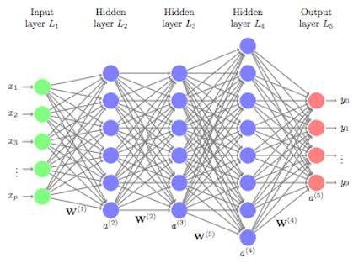
Deep Neural Network

Slide 4
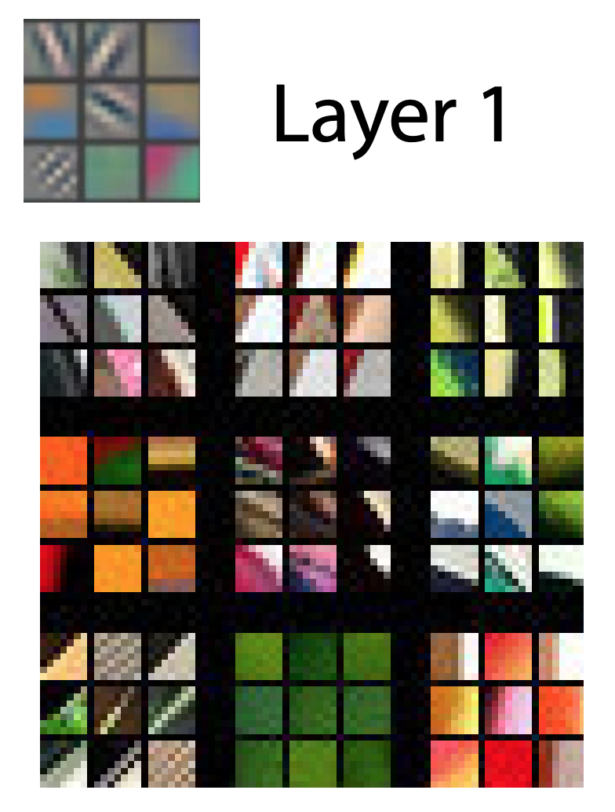
How did our Computer Vision model learn?
Visualization of identified features in a fully trained model.
Training images that most strongly matched the set of learned features visualized above.
Notes:
Only allow graduates of DL 101 to join the Slack channel to guarantee an active channel? (seems like a stupid idea but I wanted to put an online communication tool here.)

Slide 5
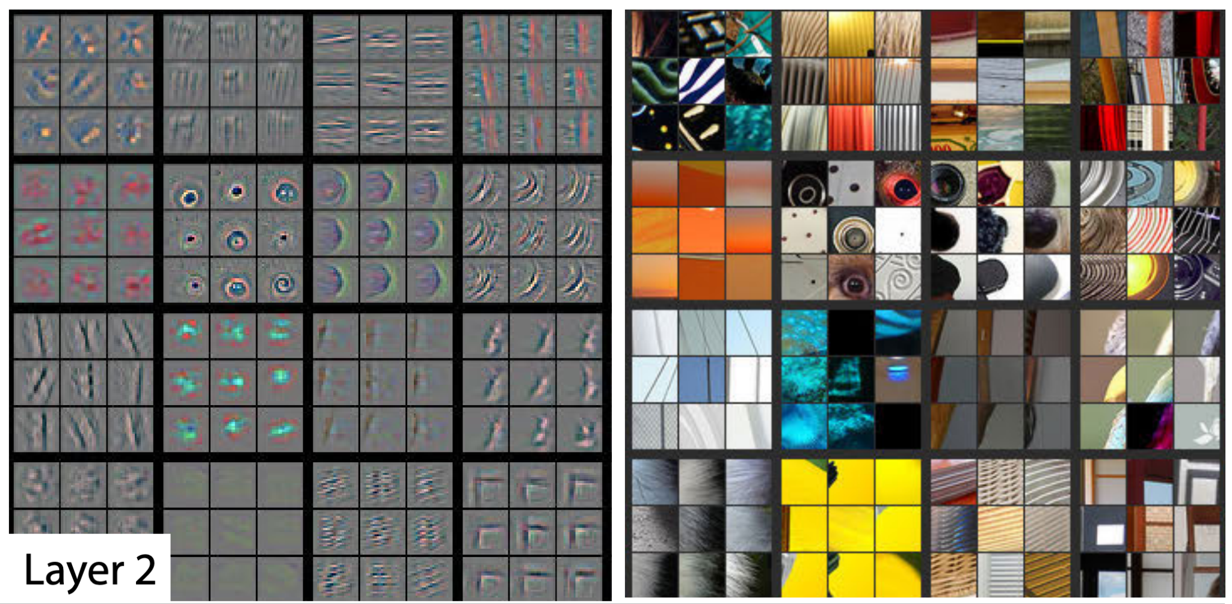
How did our Computer Vision model learn?
Layer 2 responds to corners and other edge/color conjunctions.
Notes:
Only allow graduates of DL 101 to join the Slack channel to guarantee an active channel? (seems like a stupid idea but I wanted to put an online communication tool here.)

Slide 6
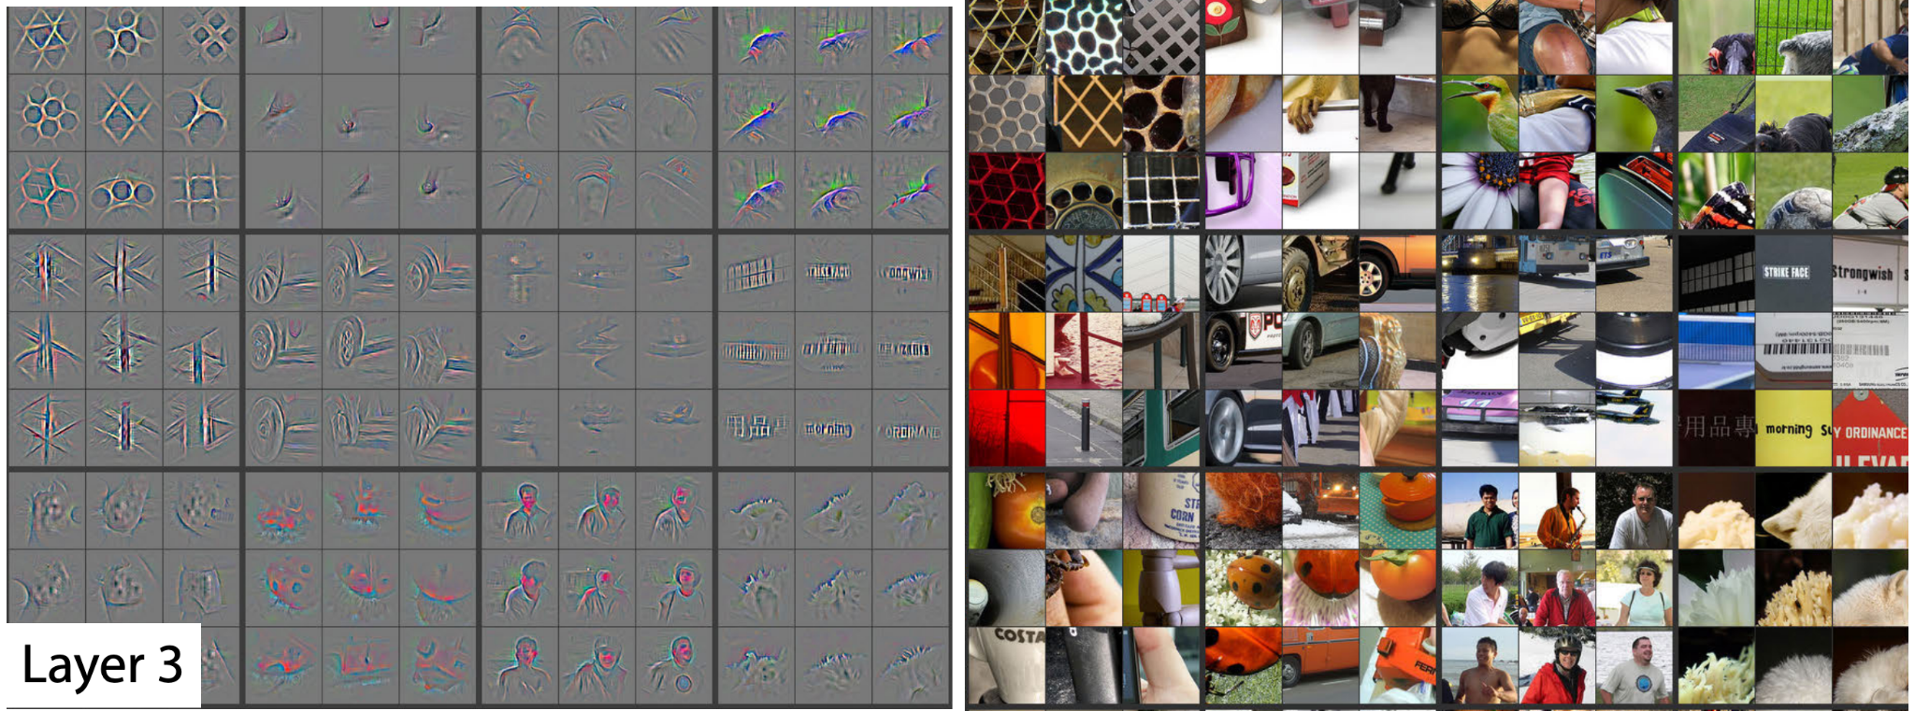
How did our Computer Vision model learn?
Layer 3 has more complex invariances, capturing similar textures
Notes:
Only allow graduates of DL 101 to join the Slack channel to guarantee an active channel? (seems like a stupid idea but I wanted to put an online communication tool here.)

Slide 7
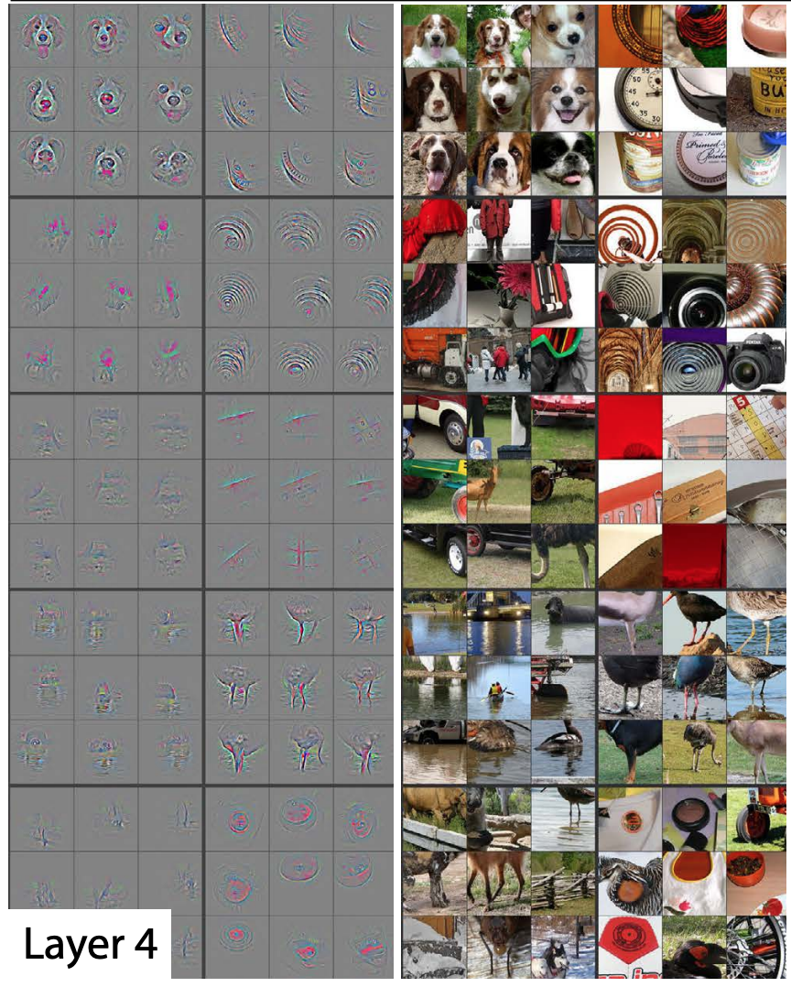
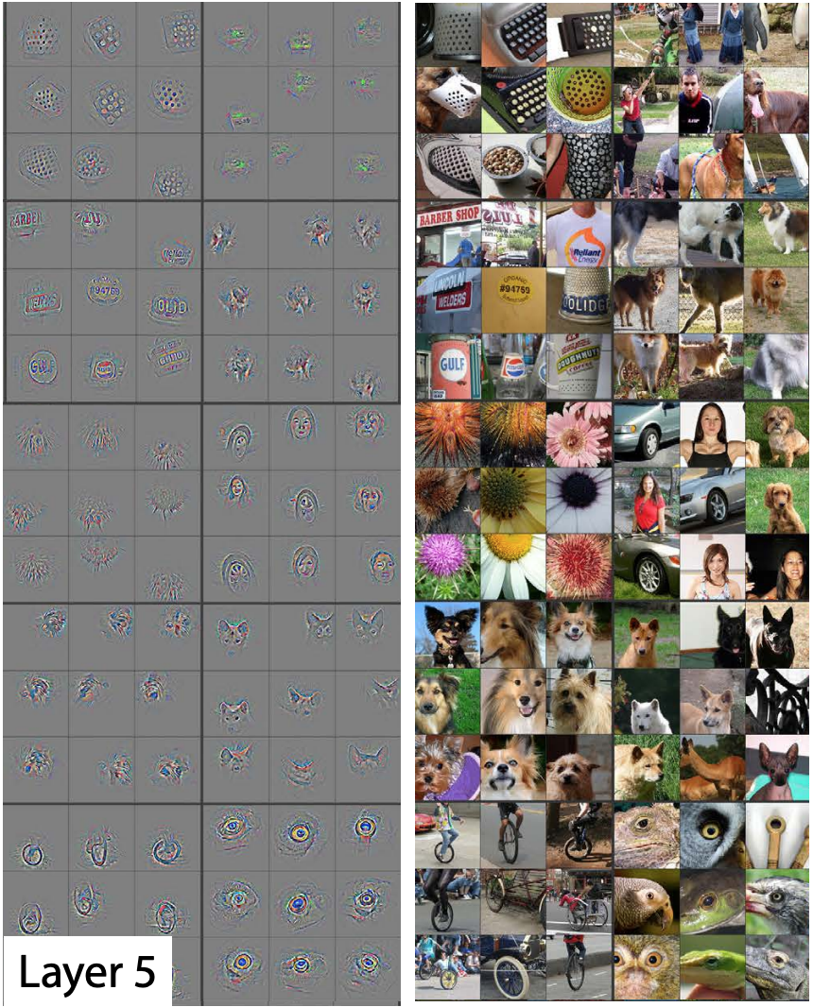
How did our Computer Vision model learn?
Layer 4 shows significant variation, but is more class-specific: dog faces (R1,C1); bird’s legs
Layer 5 shows entire objects with significant pose variation, e.g. keyboards (R1,C11) and dogs (R4)
Notes:
Only allow graduates of DL 101 to join the Slack channel to guarantee an active channel? (seems like a stupid idea but I wanted to put an online communication tool here.)

Slide 8
How did our Computer Vision model learn?
Transfer Learning: When we fine-tuned our pretrained model earlier, we adapted what those last layers focus on (flowers, humans, animals) to specialize on the teddy, grizzly, black problem. More generally, we could specialize such a pretrained model on many different tasks.
Layer 5 shows entire objects with significant pose variation, e.g. keyboards (R1,C11) and dogs (R4)
Notes:
Only allow graduates of DL 101 to join the Slack channel to guarantee an active channel? (seems like a stupid idea but I wanted to put an online communication tool here.)

Slide 9
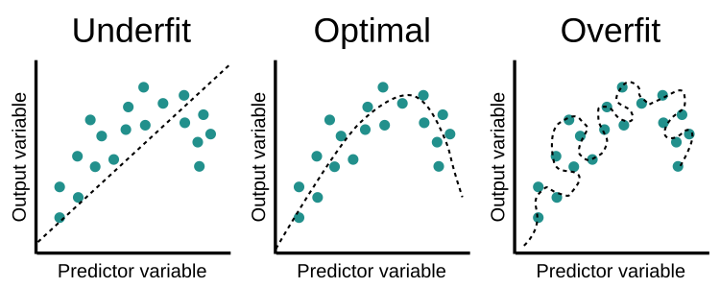
Underfitting vs Overfitting
Has not identified any kind of features/patterns.
Has identified features/patterns and is able to generalise between trained and new data points.
Has identified features/patterns too narrowly and is not able to generalise on new data points.
Notes:
Only allow graduates of DL 101 to join the Slack channel to guarantee an active channel? (seems like a stupid idea but I wanted to put an online communication tool here.)

Slide 10
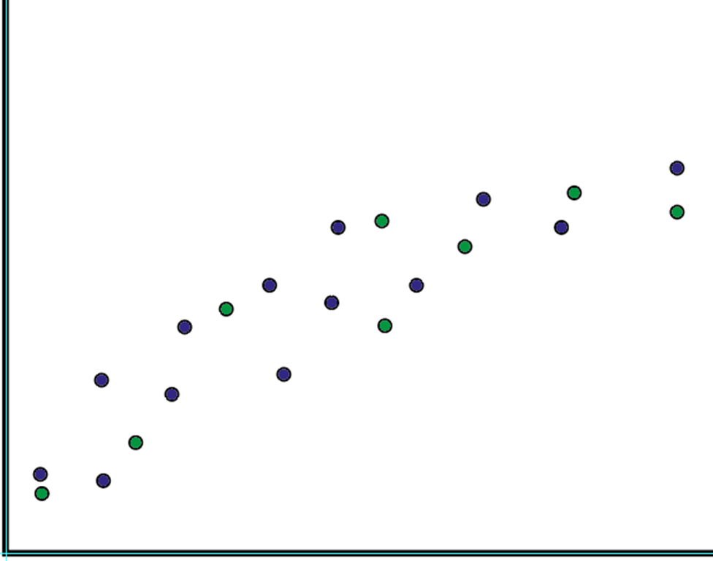
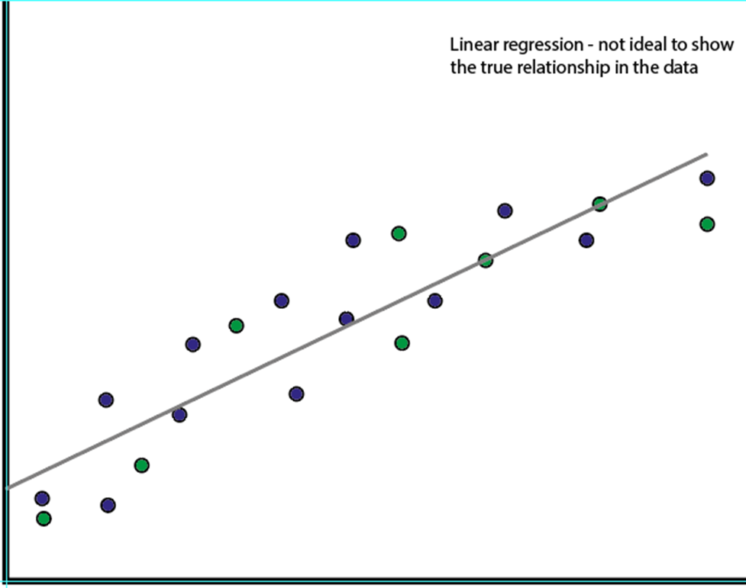
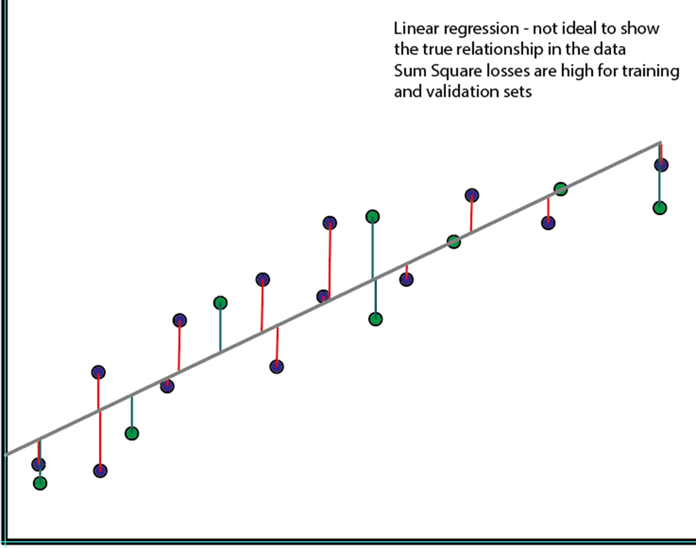
Linear Regression
Training Set in Blue
Validation Set in Green
Linear regression does not fit the data well
The sum of the square loss for both training and validation sets is high

Slide 11
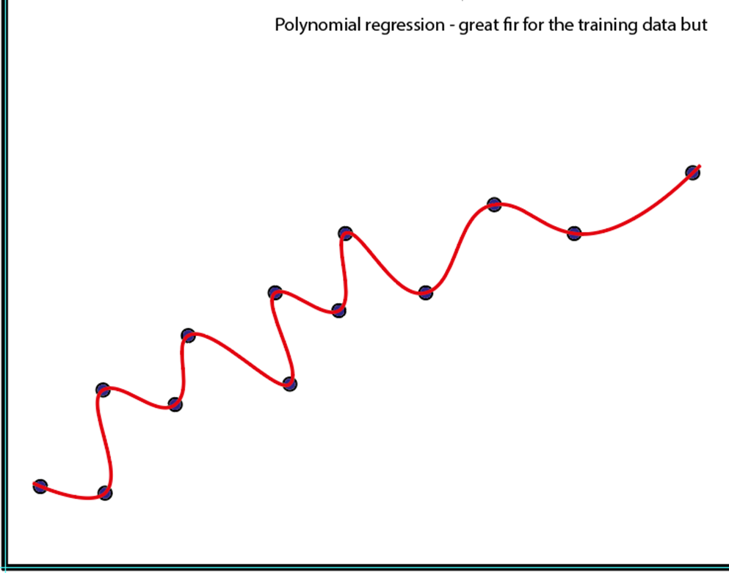
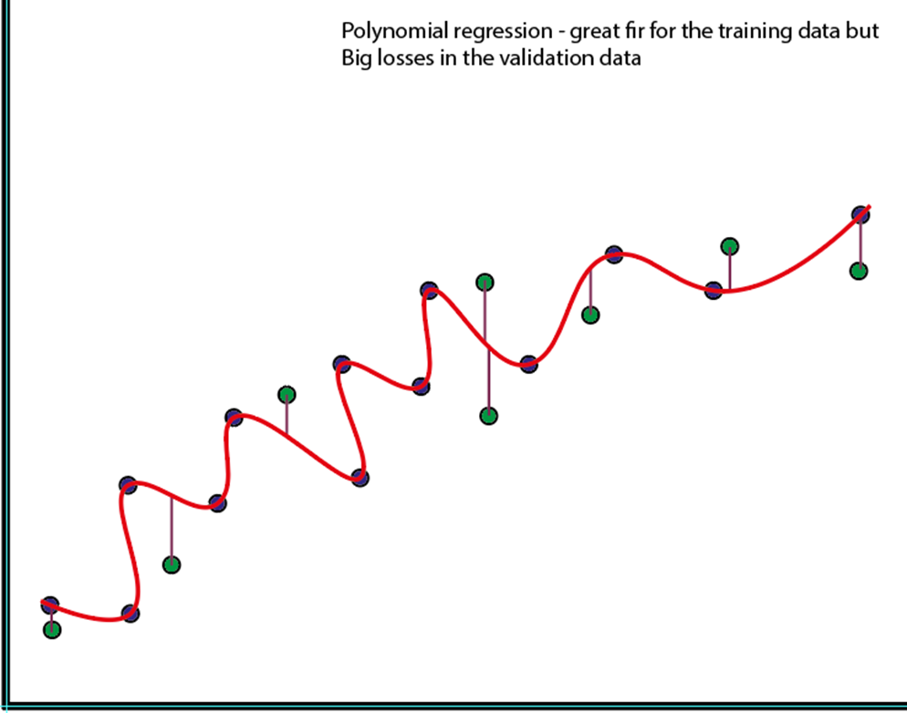
Polynomial regression
Polynomial regression (squiggly line) fits the training set well
Polynomial regression does not fit the validation set well at all. While the Square loss for the training set is low, it is high for the validation set

Slide 12
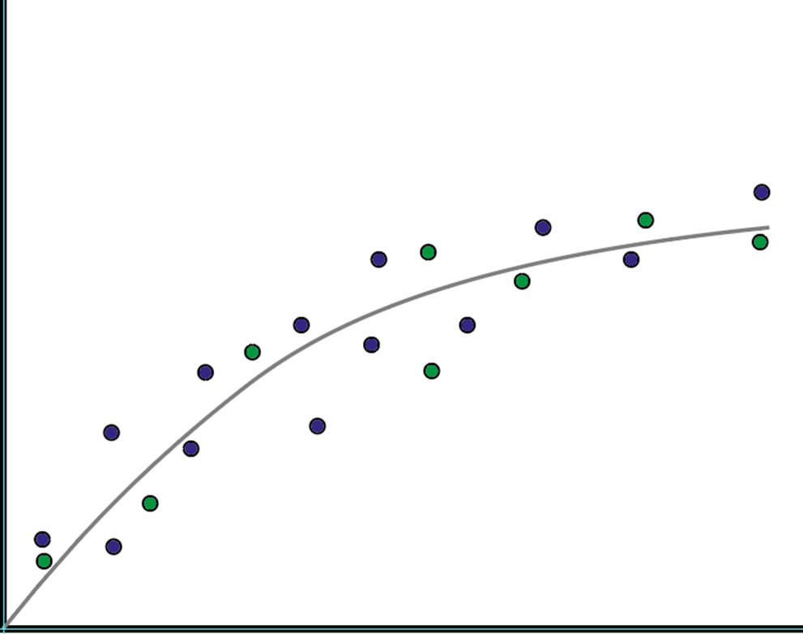
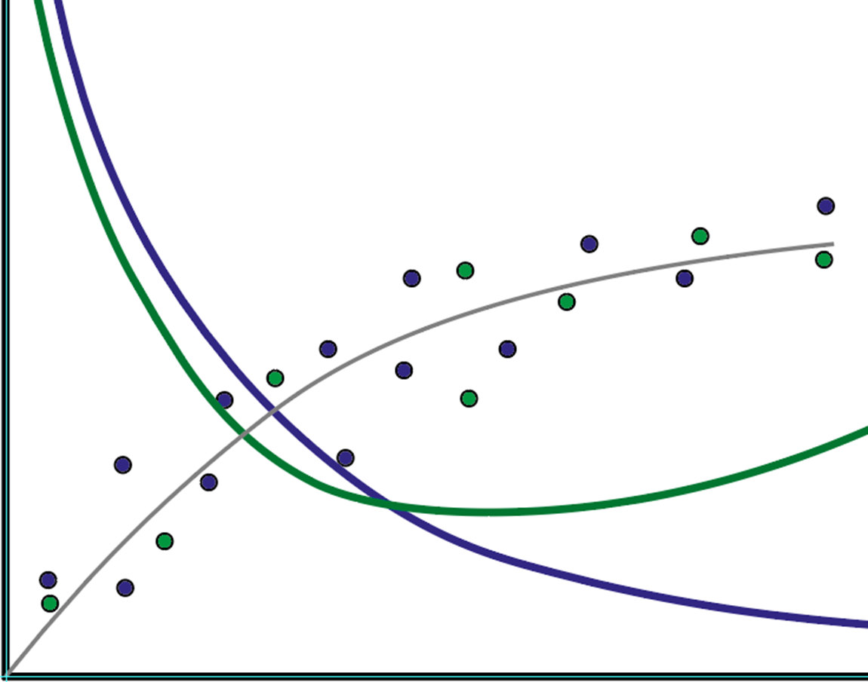
Ideal regression curve
Polynomial regression (squiggly line) fits the training set as well as the validation set.
If you look at the loss curves during training both training (blue line) and validation (green line) losses decrease. At a point they diverge and that is where over fitting starts.

Slide 13
Underfitting vs Overfitting
Cannot differentiate between mask_on and mask_off
Can differentiate between mask_on and mask_off
Can only differentiate between mask_on and mask_off on the training set but not on the validation and test set.
Notes:
Only allow graduates of DL 101 to join the Slack channel to guarantee an active channel? (seems like a stupid idea but I wanted to put an online communication tool here.)

Slide 14
Metrics: Accuracy vs Loss
Accuracy is the human metric
Loss is the machine metric. It’s measure of performance.
Accuracy / Error_rate | Validation Loss | Training Loss
% of images in val_set classified cor or incor A = 1.0 - error_rate | Loss function on the validation set Cross-Entropy Loss | Loss function on the training set Cross-Entropy Loss

Slide 15
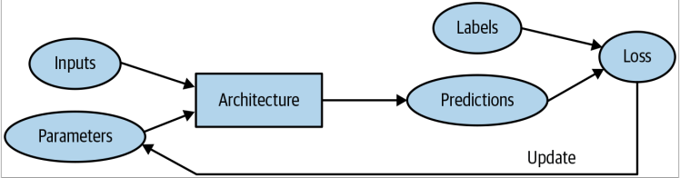
Backpropagation

Slide 16
Thanks for joining!
Discussed paper: https://arxiv.org/pdf/1311.2901.pdf

